Slide 1


VISVESVARAYA TECHNOLOGICAL UNIVERSITY
Jnana Sangama, Belagavi - 590018
Underwater Wireless Communication System
-
Department of Electronics and Communication Engineering
UNDER THE GUIDANCE OF
Prof. Mrs Dhanyashree P N
(Asst. prof)
SUBMTTED BY
SHIREESHA V 1EW20EC055
SOUNDARYA K R 1EW20EC060
SUPRIYA G K 1EW20EC061

Slide 2
CONTENTS
Abstract
Introduction
Literature Survey
Objective
Problem Statement
Methodology
Block diagram
Advantages
Result

Slide 3
ABSTRACT
Underwater wireless communication system makes use of two communication modules which transmits and receives data using LED radiation. Each module consists of both transmitter and receiver which transmits and convert received data. Wireless communication system has many advantages such as is an inexpensive and the transmitter or receiver can be showed to another location with least distraction. This system is used for easy communication with transmitter and receiver in underground water. The system consist of acknowledgement receipt message that sent back from receiving circuit to the transmitting circuit on the message receipt. This allows for efficient communication between two circuits wirelessly.

Slide 4
INTRODUCTION
The method of transmitting and receiving the information by using electromagnetic radiation in the underwater environment is called underwater wireless communication .
It an electromagnetic radiation which has wavelength longer than that of visible light but shorter than radio waves and has wavelength between (750 nm-1mm) .
The other technology which is used for underwater communication is acoustic transmission .
Communications system of the current invention consists of first and second underwater communications modules which transmit and receive data utilizing LED radiation .
This technique has wide range of applications like aquatic surveillance, underwater pollution.

Slide 5
LITERATURE SURVEY
TITLE AUTHOR YEAR AND PLACE INFERENCE
OF APPLICATION
Underwater communication system for data transmission
Shresta et al
2019
controlled laboratory environment
The LED-based communication system can achieve a high data rate with low power consumption.
LED-based underwater communication system
Saha et al.
2019
The system was tested in a real underwater environment
The results showed that the proposed system can achieve a high data rate with low error rate and low power consumption.
An LED-based underwater wireless communication system that uses a hybrid modulation scheme for data transmission
Luo et al.
2021
The proposed system was tested in a real underwater environment
The results showed that the hybrid modulation scheme can achieve a higher data rate and lower bit error rate compared to traditional modulation schemes.

Slide 6
OBJECTIVE
Wired underwater is not feasible in all situations as shown below:
Temporary experiments
Breaking of wires
Significant cost of deployment
Experiment over long distances.
To cope up with above situations, we require underwater wireless
Communication.

Slide 7
PROBLEM STATEMENT
Designing a reliable and efficient underwater wireless communication system for transmitting data over long distances with low latency and high data rates.
Therefore, there is a need for an effective and efficient method for underwater wireless communication.

Slide 8
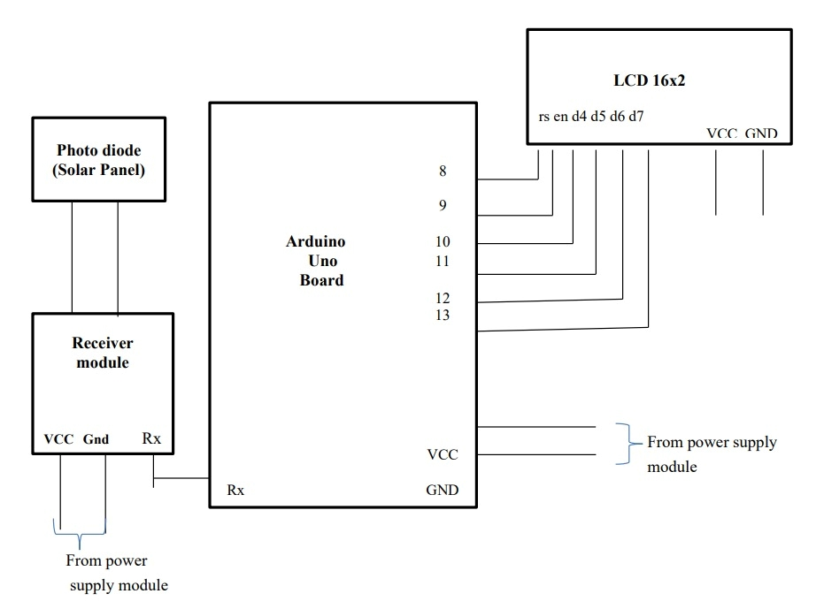
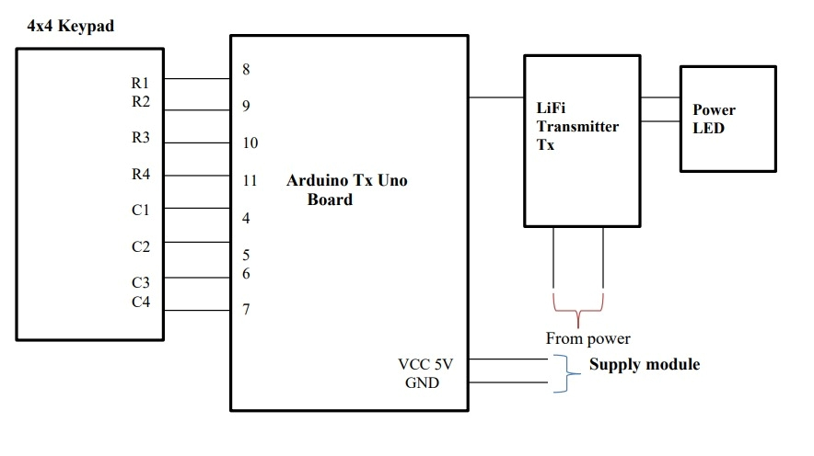
METHODOLOGY/ Block diagram
Block diagram of Transmitter Block diagram of Receiver

Slide 9
Hardware Specifications
Arduino Uno
LED’s
TSOP1738 IR Receiver
LCD’s
Crystal Oscillator
Resistors
Capacitors
Transistors
Cables & Connectors
Diodes
PCB
Transformer/Adapter
Push Button
Software Specifications
Arduino compiler
MC Programming Language: C

Slide 10
ADVANTAGES
Real-time data transmission
Remote operation
Increased mobility and flexibility
Reduced deployment and maintenance costs
Scalability
Data collection efficiency
Enhanced safety
Eco friendly solution

Slide 11
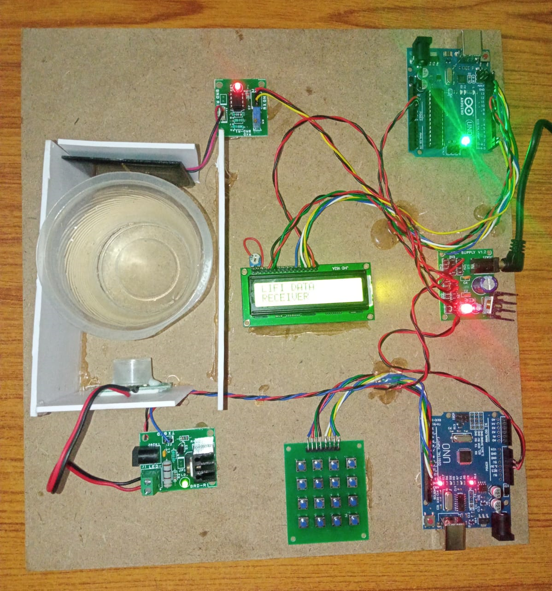
RESULT
Reliable and efficient underwater wireless communication enables high-speed data transmission, facilitating advancements in underwater exploration, research, and monitoring.

Slide 12
REFERENCES
Y. Li et al., "Underwater Wireless Infrared Communication Systems: A Review," IEEE Communications Surveys and Tutorials, vol. 22, no. 4, pp. 2382-2403, 2020
Muhammad Tahir, “Underwater Wireless Communication Using EM Waves”, October 19, 2020.
Jaruwatanadilok, S., “Underwater Wireless Optical Communication Channel Modelling and Performance Evaluation using Vector Radiative Transfer Theory”. IEEE Journal on Selected Areas in Communications, vol. 26(9): pp. 1620-1627, 2008.
Stojanovic M and Preisig J. Underwater acoustic communication channels: propagation models and statistical characterization. IEEE Common Mag 2009; 47(1): 84–89

Slide 13
Thank you

